Slide 1
Arcade: Early Dynamic Property Evaluations of Software Architectures
Jim Holt and Suzanne Barber
The University of Texas at Austin
Notes:
EE382C Software Architectures

Slide 2
Early Architecture Evaluation saves!
Early architecture evaluation involves applying tools and techniques to the analysis of specific properties (e.g., correctness, reliability, performance) in high-level, abstract architectural models that can be specified early in the system development process.
Early evaluation can:
  Identify requirements errors when they are less costly to correct
  Aid in managing requirements evolution
  Provide system implementation guidance
This research involves integrating a number of evaluation techniques and leveraging a formal requirements metamodel for early and iterative dynamic property evaluation.
Notes:
EE382C Software Architectures

Slide 3
Early Architecture Evaluation
Early Architecture Evaluations are:
  Performed before implementation
  Performed through iteration as the system evolves
  Performed in the language of the mamain
    Makes evaluation accessible to a host of stakeholders
  Performed using partial models
    Evaluation can proceed concurrently with requirements acquisition and modeling
Early evaluations can provide useful insight into runtime (dynamic) properties of a system
Fast moving development efforts need a tool for rapid insightful feedback.
Notes:
EE382C Software Architectures

Slide 4
Motorola eDesign Project
“On-going effort within Motorola’s Semiconductor Products Sector (SPS) Information Technology group to deliver the most current and concise SPS product technical information and collateral products to both internal and external customers with speed and efficiency.”
Notes:
EE382C Software Architectures

Slide 5
eDesign Business Blueprint
Motorola
Content Delivery
Content Administration
Document Authoring
Configuration Management
Author
External Customer
Product Owner
Internal Customer
Collateral Administrator
Notes:
EE382C Software Architectures

Slide 6
Some eDesign Usage Profiles
Usage Profile
Frequency
Tasks
Performer
Duration
Publish New Collateral
medium
Add Collateral File
Collateral Admin
high
Launch Collateral
Collateral Admin
low
Publish New Product
medium
Create Product Summary Page
Product Owner
high
Associate Collateral to PSP
Product Owner
med
Launch PSP
Product Owner
low
Associate PSP to a Category
Product Owner
low
Access Product Information
high
Search for Product
Customer
med
Select PSP
Customer
low
Download Product Collateral
Customer
high
Publish New Technical Document
medium
Create Technical Documentation
Author
high
Create Technical Document Metadata
Author
high
Check In Technical Documentation
Author
low
Check In Technical Document Metadata
Author
low
Stage Technical Documentation
Publisher
med
Update Collateral
low
Stage Collateral
Collateral Admin
low
Update Collateral Attributes
Collateral Admin
high
Launch Collateral
Collateral Admin
low
Update Product
low
Stage Product
Product Owner
low
Update Product
Product Owner
high
Launch Product
Product Owner
low
Notes:
EE382C Software Architectures

Slide 7
Software Architecture Properties
  Static properties are non-runtime properties such as consistency, maintainability, and reusability.
  Dynamic properties are runtime properties such as correctness, reliability, and performance.
Notes:
EE382C Software Architectures

Slide 8
Arcade Evaluation
Property Evaluated | Technique Applied
Correctness – Execution Completeness | Guided state space exploration
Correctness – Safety | Model checking
Correctness – Liveness | Model checking
Reliability | Probabilistic graph model algorithms
Performance | Discrete event simulation
Notes:
EE382C Software Architectures

Slide 9
Dynamic Correctness Properties
  Completeness – “the system reflects the features required by stakeholders”
  Safety – “the system does not reach any invalid end state”
  Liveness – “no unreachable states exist in the system”
Notes:
EE382C Software Architectures

Slide 10
ARCADE Correctness Evaluation
Process
Process
:: /* Associate_Collateral_to_PSP Service */
/* PreConditions */
(
Product_Owner.Associate_Collateral_to_PSP
Product_Owner.Associate_Collateral_to_PSP
Product_Owner.Associate_Collateral_to_PSP
Product_Owner.Associate_Collateral_to_PSP
Product_Owner.Associate_Collateral_to_PSP
)
-->
/* consume events and data */
atomic {
Product_Owner.Associate_Collateral_to_
Translation
Translation
Translation
Promela
Promela
Promela
Promela
Model
PROMELA (Process or Protocol Meta Language) is a verification modeling language introduced by Gerard J. Holzmann. The language allows for the dynamic creation of concurrent processes to model, for example, distributed systems.
Model
Model
Architecture
Model
Architecture
Architecture
Specification
Specification
Specification
SPIN
SPIN
Corrections ?
SPIN
Corrections ?
Corrections ?
SPIN
472, state 40, "Product_Owner.events.Category_is_
474, state 41, "Product_Owner.events.Category_is_
478, state 46, "-end-"
proctype Author_Model
487, state 1, "(1)"
488, state 2, "-end-"
f 2 states)
proctype Publisher_Model
497, state 1, "(1)"
498, state 2, "-end-"
f 2 states)
Yes
Yes
Yes
Verifier
Verifier
Verifier
No
No
No
Issues ?
Issues ?
Issues ?
Done
Done
Done
Counter
Counter
Counter
Results
Example
Example
Example
Spin is a popular open-source software verification tool,The tool can be used for the formal verification of multi-threaded software applications.
Interpretation
Interpretation
Interpretation
Notes:
EE382C Software Architectures

Slide 11
Completeness Errors
Completeness errors are manifested in sequences of service executions that do not meet stakeholder expectations, including:
  Missing service executions
  Unexpected service executions
  Missing execution paths
  Unexpected execution paths
Notes:
EE382C Software Architectures

Slide 12
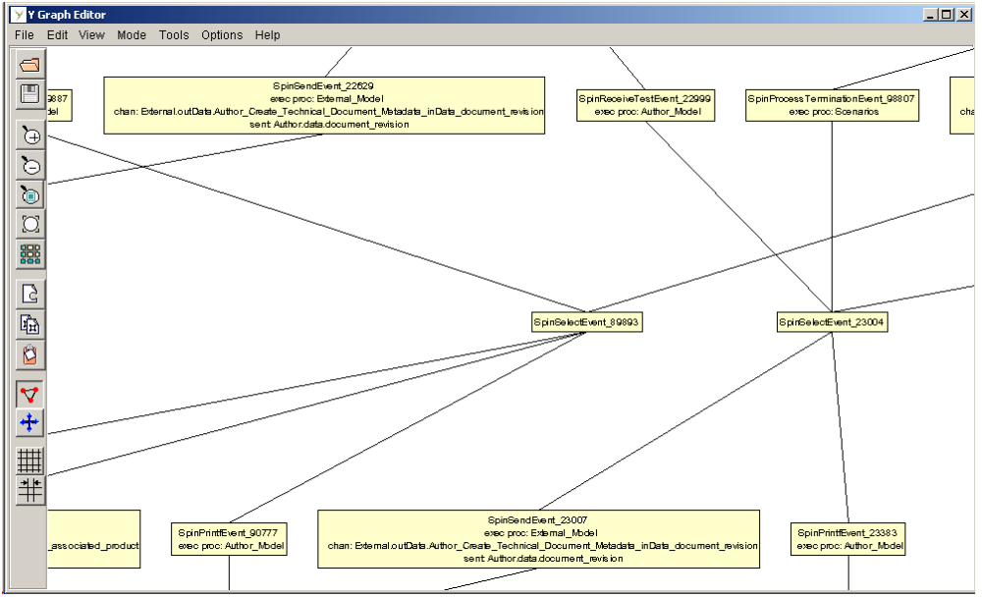
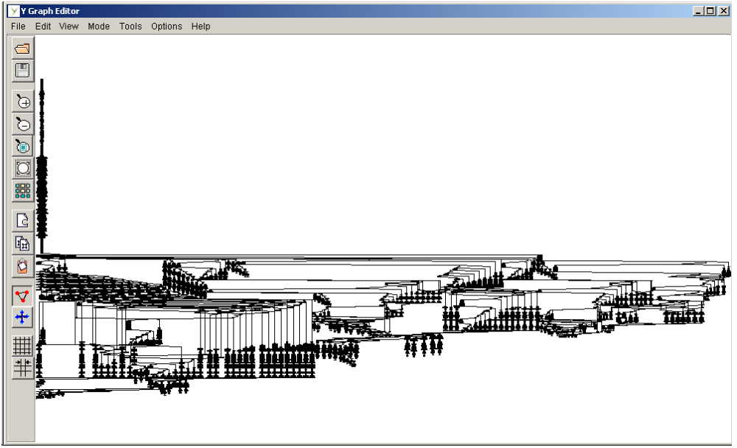
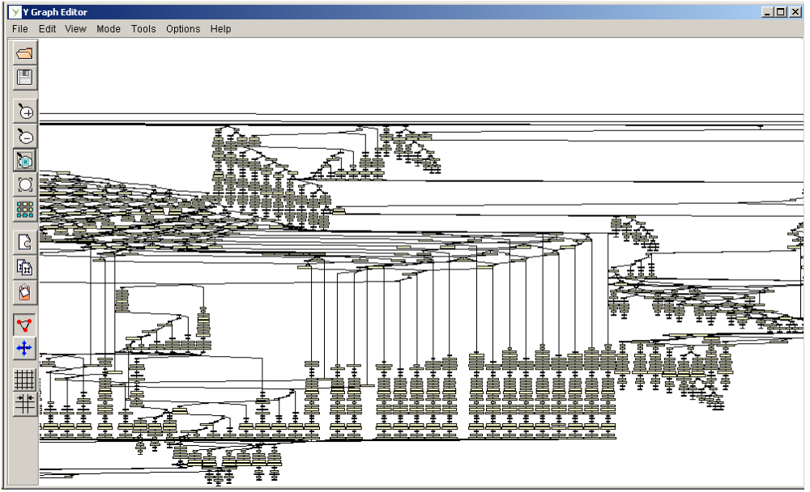
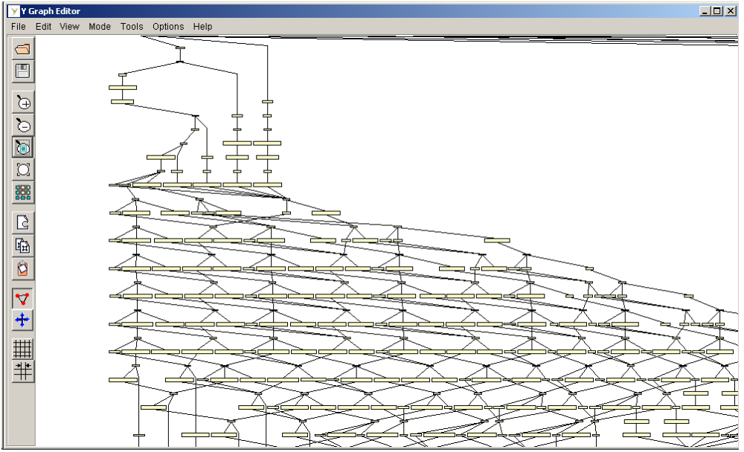
The Low-level State Space
Arcade provides a mechanism to reduce the complexity of the low-level state space and to present completeness visualizations to stakeholders in intuitive terms:
The Execution Space
- Includes only Service Executions and possible Threads of Execution
Notes:
EE382C Software Architectures

Slide 13
Arcade Safety Property
Informally - “the system does not terminate in an invalid end state”, including:
    Unterminated service executions
    Unreceived events or data
Unterminated service executions occur when post-conditions cannot be satisfied.
Unreceived events or data occur as a result of pre-condition or post-condition specification errors.
Arcade presents SPIN safety property violation counterexamples using an Architecture Trace Diagram (ATD), an extension to ITU Message Sequence Charts
Notes:
EE382C Software Architectures

Slide 14
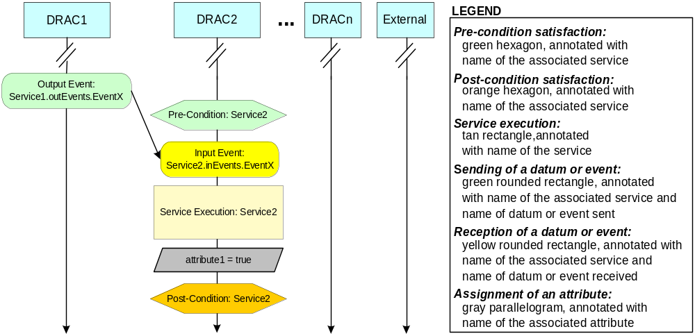
Architecture Trace Diagrams
BBC 1
BBC 2
BBC 3
Notes:
EE382C Software Architectures

Slide 15
Arcade Liveness Property
Informally – “the system eventually enters all desirable states”, including:
  No unreachable services exist
  All required paths between services are traversable
Unreachable services occur when an entire service pre-condition is never satisfiable.
Untraversable paths occur when a disjunct sub-expression of a service pre-condition is never satisfiable.
Arcade presents SPIN liveness property violation counterexamples by indicating which pre-conditions are not satisfiable.
Notes:
EE382C Software Architectures

Slide 16
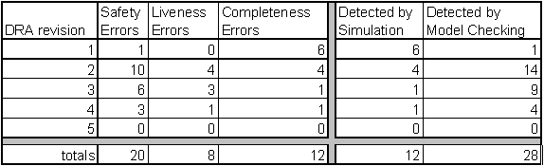
eDesign Correctness Evaluation Results
  57% of errors were specification errors
  43% of errors were conceptual integrity errors
BBC revision
Notes:
EE382C Software Architectures

Slide 17
Arcade Reliability Evaluation
Arcade evaluates how sensitive the reliability of an Architecture is to the reliability of individual elements of the architecture.
  Goal is to help stakeholders understand the overall system reliability as a function of reliability of services, Business Blueprint Components, etc.
Notes:
EE382C Software Architectures

Slide 18
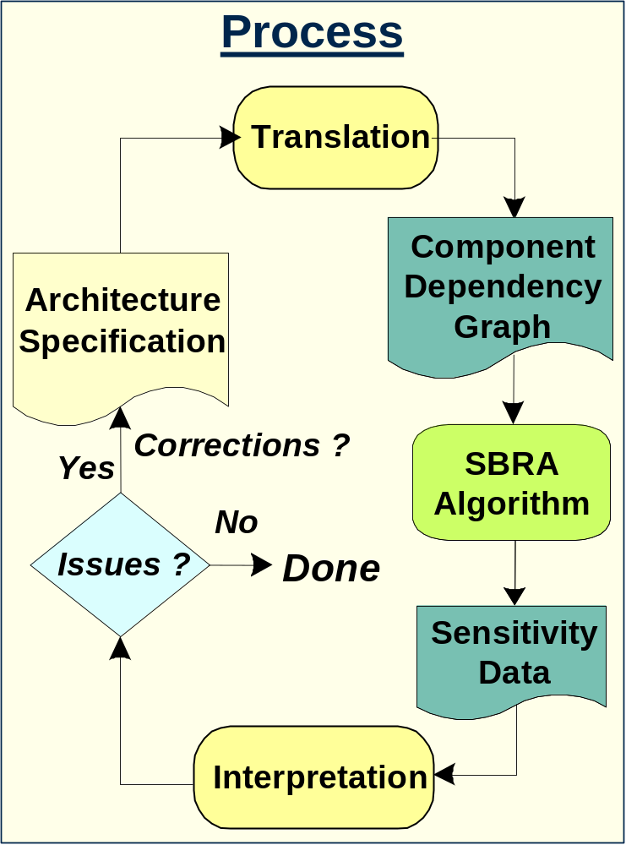
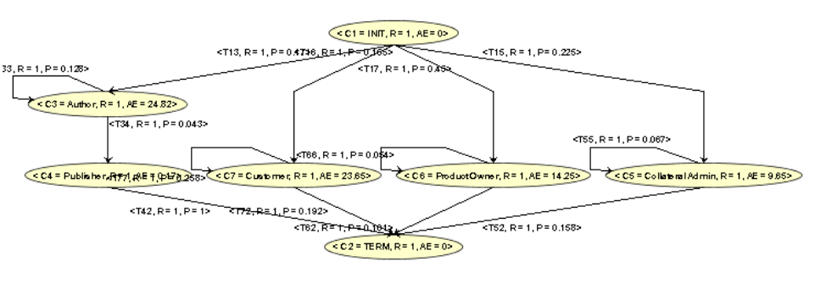
Arcade Reliability Evaluation
0.975464
0.97546384
0.975464
0.975464
0.975464
0.974964
0.878917456
0.835836
0.878917
0.960836
0.974464
0.782371072
0.705782
0.782371
0.946207
0.973964
0.685824688
0.585302
0.685825
0.931579
0.973464
0.589278304
0.474395
0.589278
0.916951
0.972964
0.49273192
0.373062
0.492732
0.902323
0.972464
0.396185536
0.281302
0.396186
0.887694
0.971964
0.299639152
0.199116
0.299639
0.873066
0.971464
0.203092768
0.126504
0.203093
0.858438
0.970964
0.106546384
0.063465
0.106546
0.84381
Notes:
EE382C Software Architectures

Slide 19
Early Performance Measures
System Wide Performance Properties
  Percent utilization: amount of time spent performing work
  Service Latency: mean service execution time for all services
  Usage Profile Latency: mean usage profile execution time for all usage profiles
BBC Performance Properties
  Percent utilization: amount of time spent performing services contained in BBC/TS
Notes:
EE382C Software Architectures

Slide 20
Early Performance Measures
Service Performance Properties
  Percent utilization: amount of time spent performing a service
  Service Latency: mean execution time of a service
  Service Throughput: mean executions/unit time of a service
Usage Profile Performance Properties
  Usage Profile Latency: mean execution time of a usage profile
  Usage Profile Throughput: executions per unit time of a usage profile
Notes:
EE382C Software Architectures

Slide 21
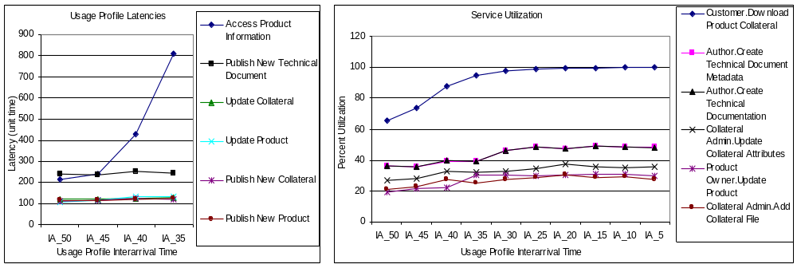
eDesign Performance Evaluation Results
for Implementation Guidance
Implementation Guidance:
System Implementers should seek to design the system so that the utilization of “Download Product Collateral” does not exceed 75%
These two elements are related since the “Download Product Collateral” Service is part of the “Access Product Information” Usage Profile.
Arcade identified the “Download Product Collateral” Service as a critical element that saturates as the system becomes increasingly loaded.
Notes:
EE382C Software Architectures

Slide 22
Overall eDesign Observations
eDesign developers were NOT model checking and simulation experts
eDesign dynamic analysis:
  Uncovered specification errors in the BB
  Helped highlight critical services
    Even when the critical nature of such services was intuitive, Arcade results offered developers rationale for justifying decisions to management
eDesign developers acknowledged cost savings from detecting errors early
    These errors would have otherwise gone undetected until implementation (e.g., unintended paths in the execution model)
Notes:
EE382C Software Architectures

Slide 23
Summary
Early dynamic property evaluation is beneficial, but is difficult for non-experts to perform using “off-the-shelf” tools and techniques.
Arcade reduces need for developer expertise by:
  Translating from Architecture to appropriate evaluation tool representation, and
  Providing easily interpreted analysis results in terms of the Architecture
Notes:
EE382C Software Architectures

